Slide 1


Detection and processing of visible-light signals for indoor navigation
TeCIP institute
Scuola Superiore Sant’Anna
Louis FOUCHER

Slide 2



Overview
Introduction
Work done
Conclusion
1.1. Presentation of the internship location
1.2. Background
2.1. Experimental setup
2.2. Choice of board
2.3. Lamp differentiation
2.4. Code improvement and testing
2.5. XY position
2.6. System errors and limitations

Slide 3
Introduction
1. INTRODUCTION
2. WORK DONE
3. CONCLUSION

Slide 4
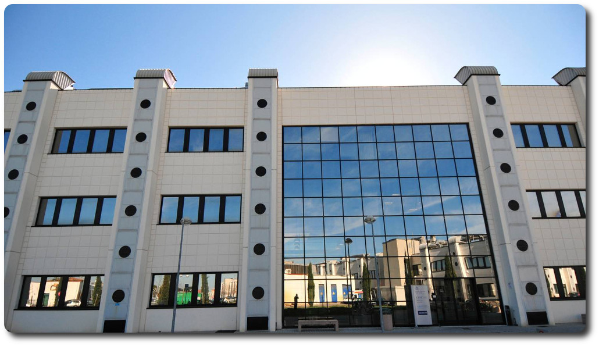
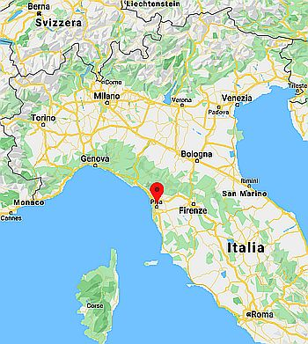
1.1. Presentation of the internship location
TeCIP The Telecommunications, Computer Engineering, and Photonics Institute
of the Scuola Superiore Sant’Anna
In Pisa
Created in 2001
As a center of Excellence funded by the Italian University, Scientific and Technological Research Ministry
1. INTRODUCTION
2. WORK DONE
3. CONCLUSION
Notes:
Présentation de l’unniv

Slide 5

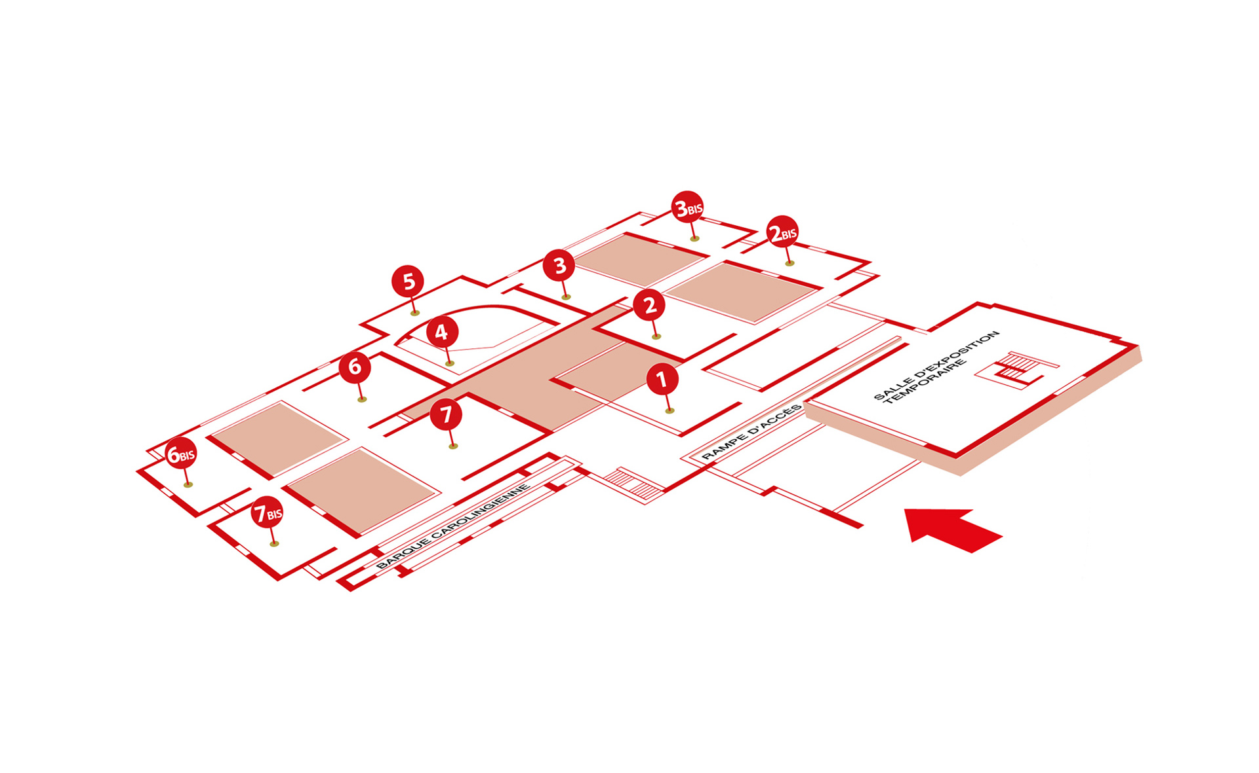





1.2. Background
Indoor Positioning
Several technologies to do indoor positioning exist like :
Wi-Fi, RFID, Bluetooth, Ultrasound, Infrared, Camera vision, VLC (Visible Light Communication)
Why VLC (Visible Light Communication) ?
Less perturbation
No frequency band overload
1. INTRODUCTION
2. WORK DONE
3. CONCLUSION
Notes:
Introduction au projet, mise en contexte

Slide 6
Work done
Detection and processing of visible-light signals for indoor navigation
1. INTRODUCTION
2. WORK DONE
3. CONCLUSION
Notes:
Diapo de transitions + étapes réalisées pour que le système fonctionne

Slide 7
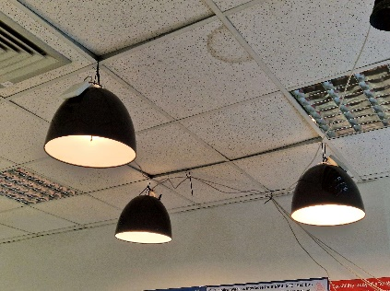
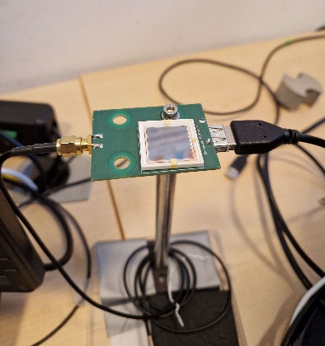
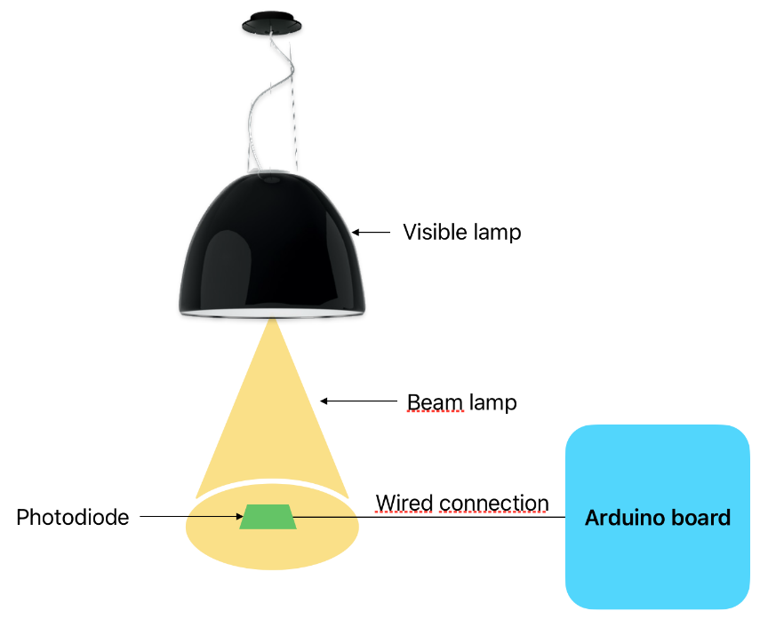
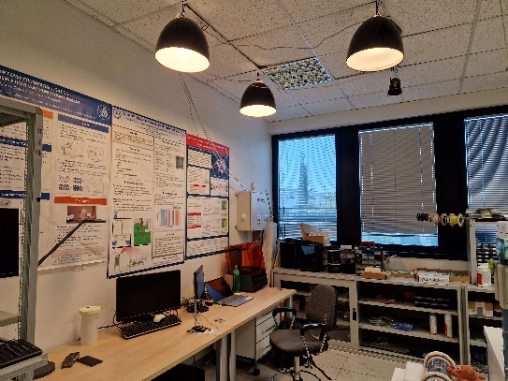
2.1. Experimental setup
Lamps LED
Photodiode
Setup as a whole
1. INTRODUCTION
2. WORK DONE
3. CONCLUSION
Notes:
Présentation du setup expérimentale

Slide 8
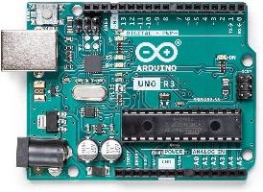
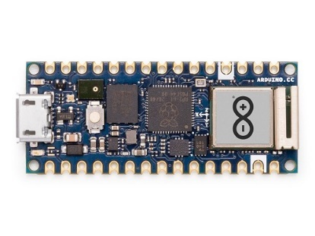
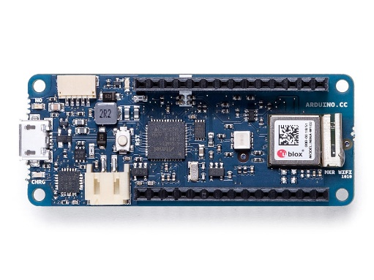
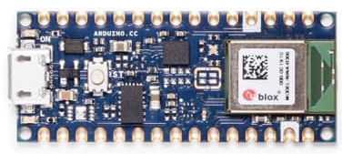
2.2. Choice of board
Name | Chip | Memory |  | Clock
 |  | FLASH | SRAM
Arduino UNO | ATmega328P | 32 KB | 2 KB | 16 MHz
Arduino Nano RP2040 connect | RP2040, DUAL CORE ARM CORTEX M0+ | 16 MB | 264 KB | 133 MHz
Arduino MKR WiFi 1010 | SAMD21 Cortex®-M0+ 32bit low power ARM® MCU | 256 KB | 32 KB | 48 MHz
Arduino Nano 33 BLE | nRF52840 | 1 MB | 256 KB | 64 MHz
1. INTRODUCTION
2. WORK DONE
3. CONCLUSION
Notes:
Pourquoi avoir choisi l’arduino RP2040

Slide 9
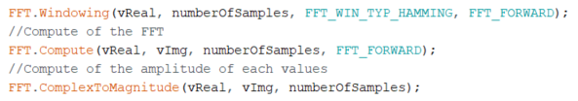
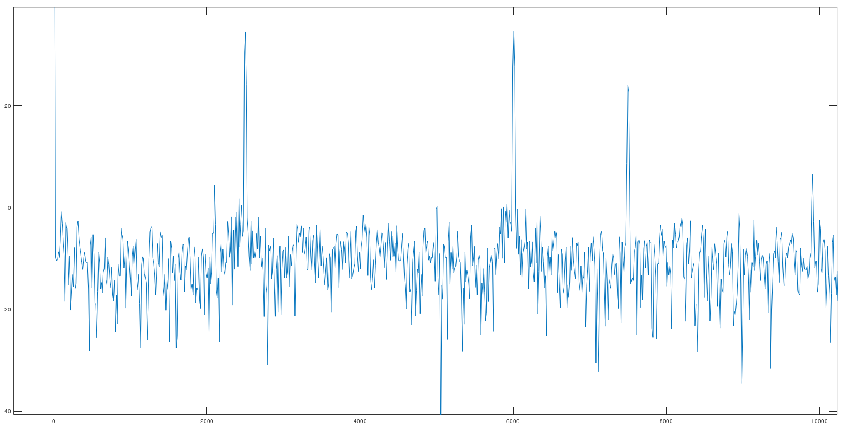
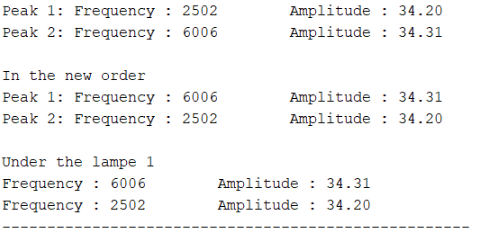
2.3. Lamp differentiation
ADCInput library
from the board package Raspberry PI Pico/RP2040 by Earle F. Philhower
Harmonic of peak 1 = 3 times the frequency of this peak.
1. INTRODUCTION
2. WORK DONE
3. CONCLUSION
Notes:
Première étape du projet, voir la lampe

Slide 10
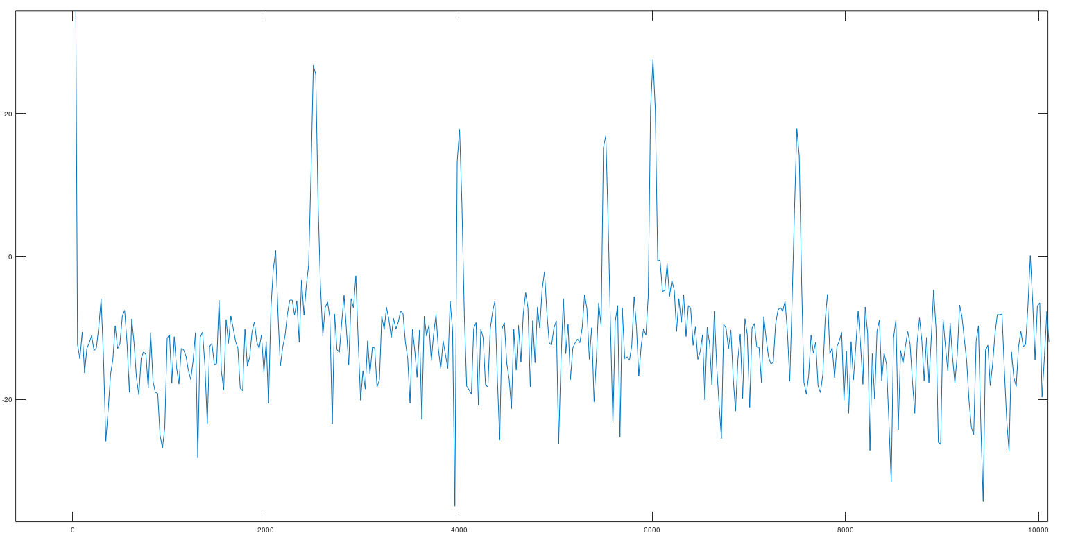
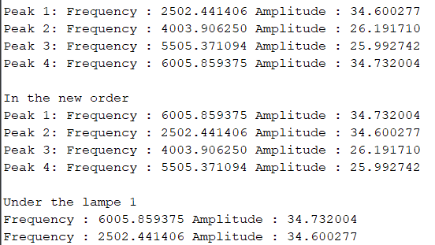
2.3. Lamp differentiation
Lamp 1
Lamp 2
With 2 lamps turn on
1. INTRODUCTION
2. WORK DONE
3. CONCLUSION
Notes:
Voir les 2 lampes et les différencier

Slide 11
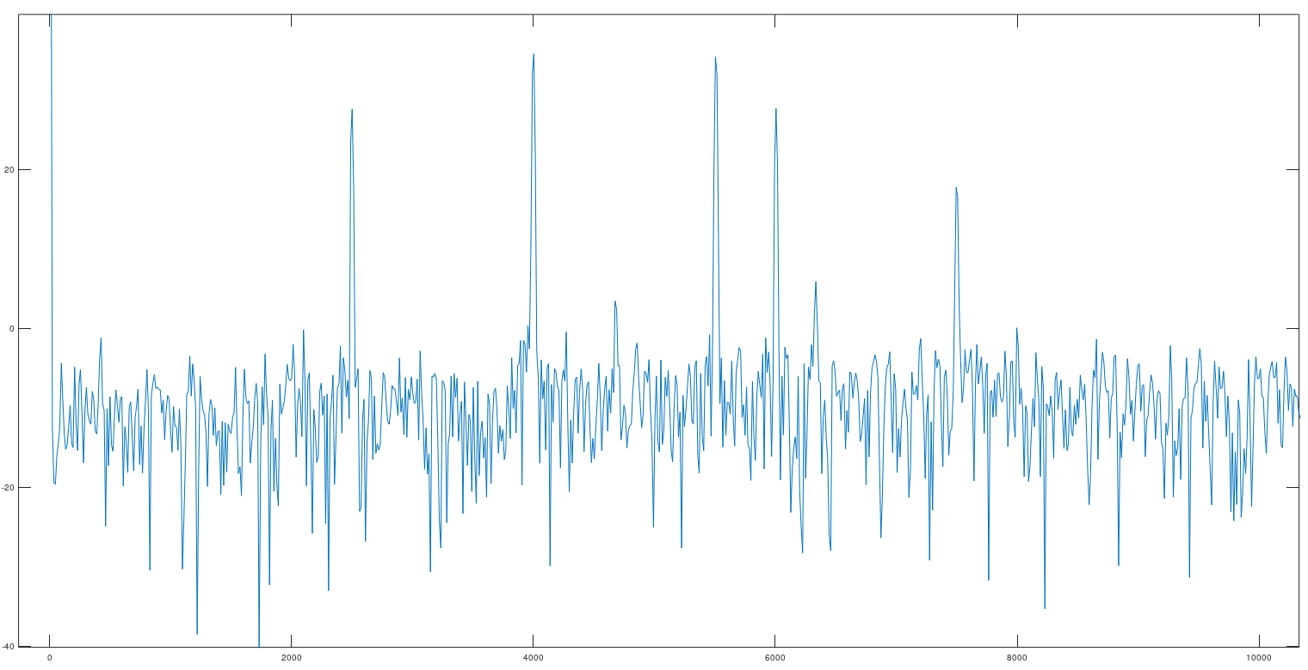
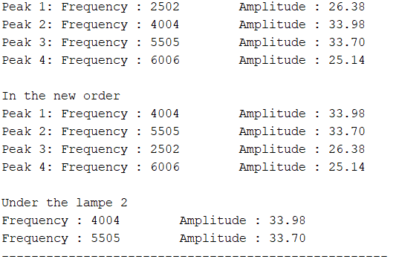
2.3. Lamp differentiation
If we are under the second lamp, the 2 largest peaks are those corresponding to lamp 2
1. INTRODUCTION
2. WORK DONE
3. CONCLUSION
Notes:
Montrer que je les différencie bien

Slide 12
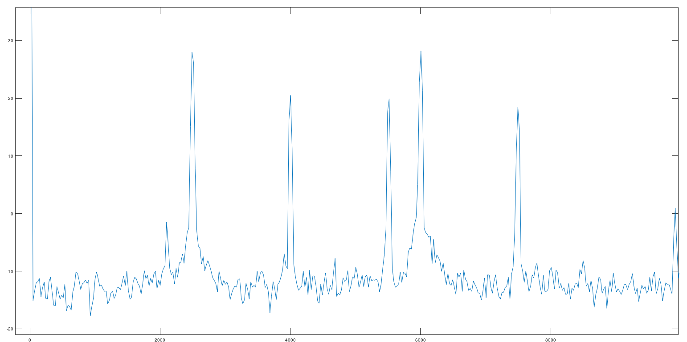
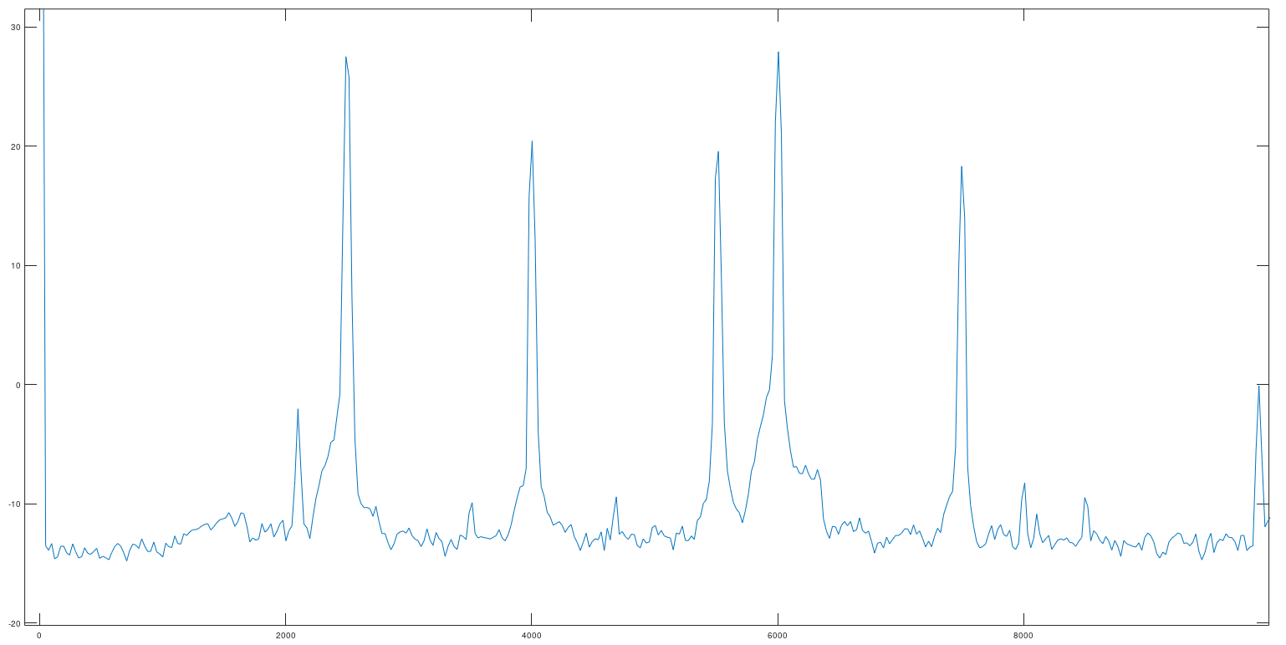
2.4. Code improvement and testing
Averaging
Averaging of 10 acquisitions
Averaging of 100 acquisitions
1. INTRODUCTION
2. WORK DONE
3. CONCLUSION
Notes:
Réduction du bruit pour rendre le système plus robuste

Slide 13
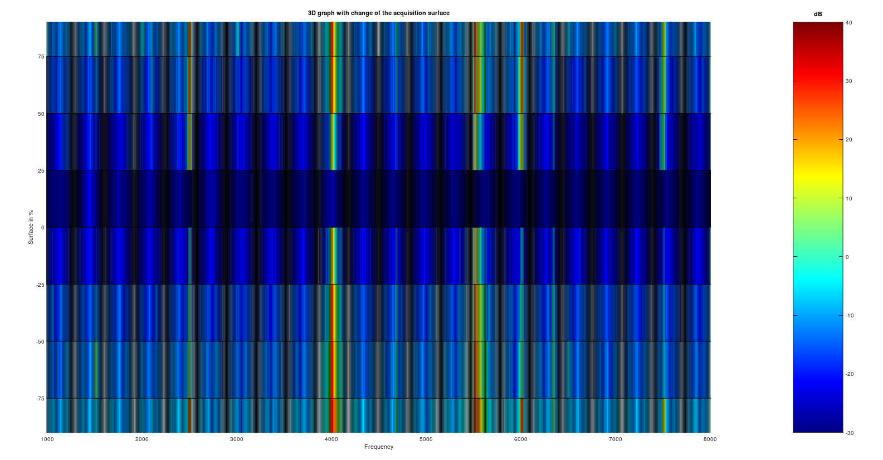
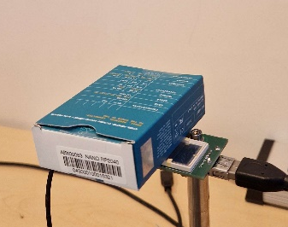
2.4. Code improvement and testing
Minimized surface
What happens if an object is placed above the sensor?
dB
Test performed with different minimization of the sensor area: 0% ; 25% ; 50% ; 75% ; 100%
On each side of the sensor
Peaks corresponding to the 2 different lamps
1. INTRODUCTION
2. WORK DONE
3. CONCLUSION
Notes:
Comportement du système lorsque l’on recouvre la surface du capteur

Slide 14
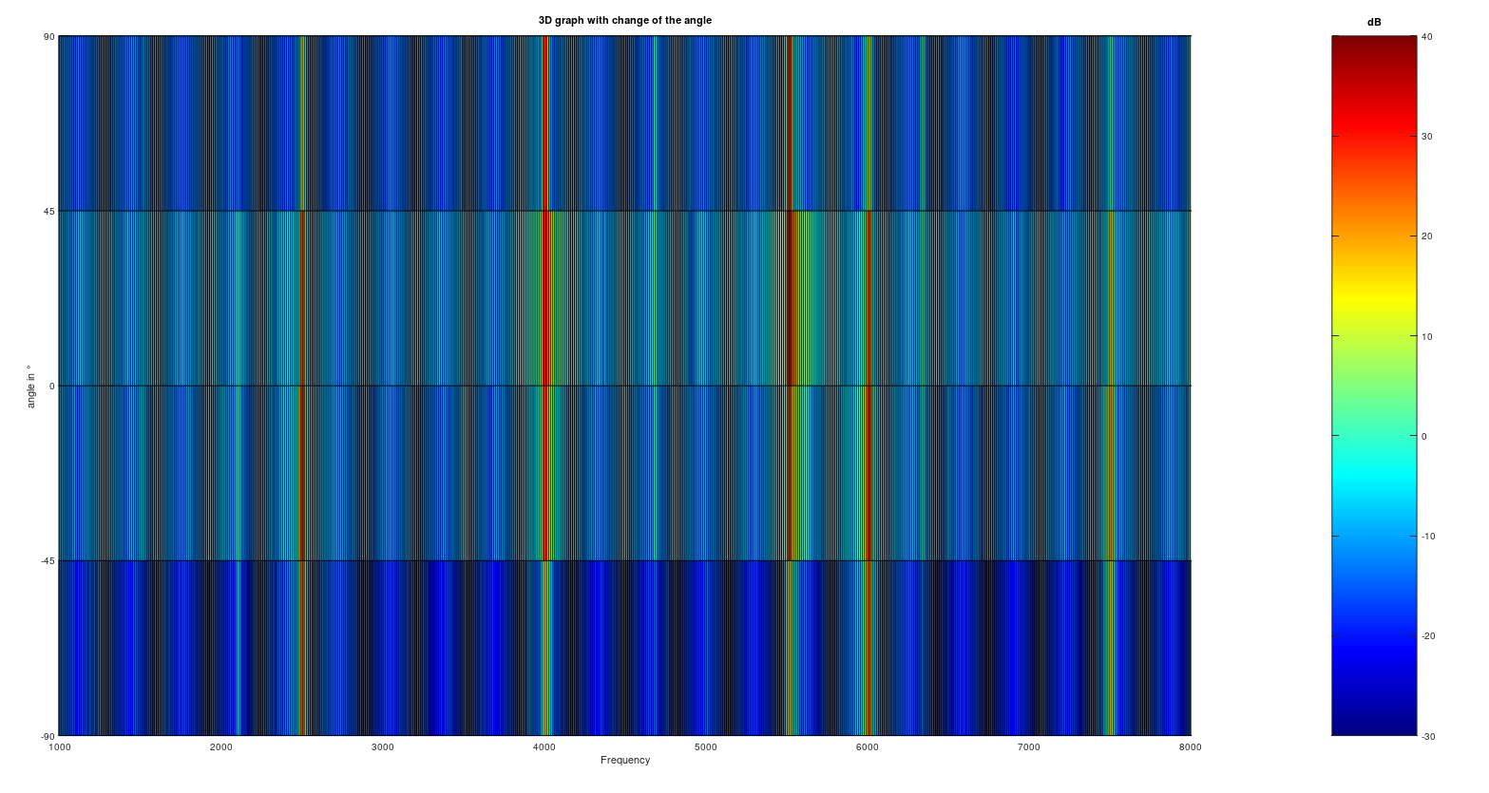
2.4. Code improvement and testing
Angle of sensor
dB
Lamp 1
What impact would it have if the sensor wasn't straight?
Test performed by varying the angle of the sensor, positioning it at 90°; 45°; 0° on each side
Lamp 2
1. INTRODUCTION
2. WORK DONE
3. CONCLUSION
Notes:
Comportement du système lorsque l’on change l’inclinaison du capteur

Slide 15
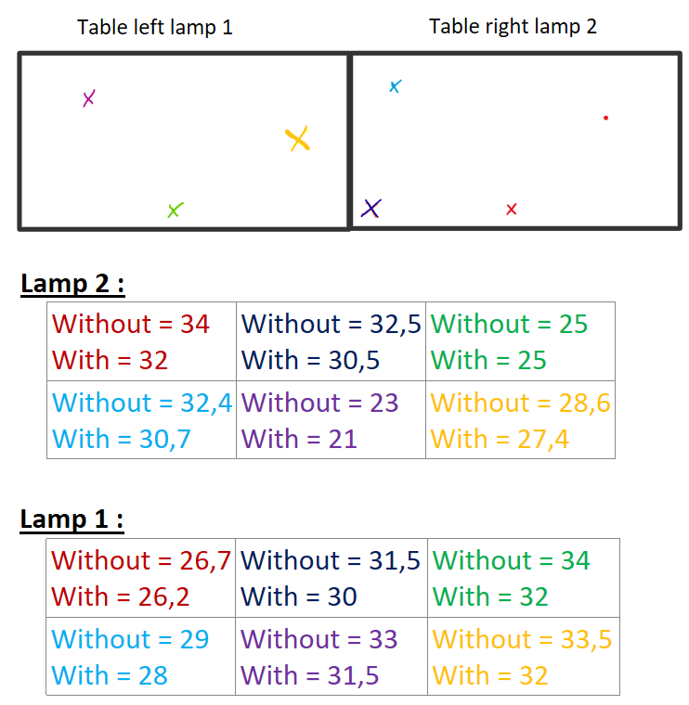



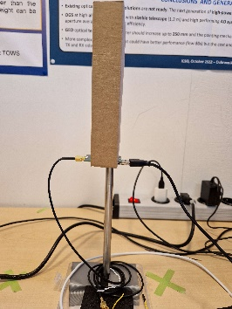
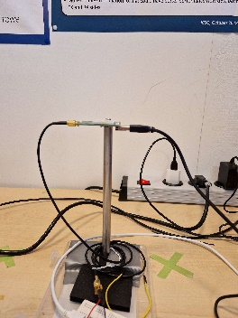



2.4. Code improvement and testing
Effect of reflection
For the farthest lamp:
Less than 1 dB due to the reflexion
For the nearest lamp:
Around 2 dB due to the reflexion
Test sensor with box (no reflexion)
Test sensor without box (reflexion)
1. INTRODUCTION
2. WORK DONE
3. CONCLUSION
Notes:
Effet de la réflexion du mur

Slide 16
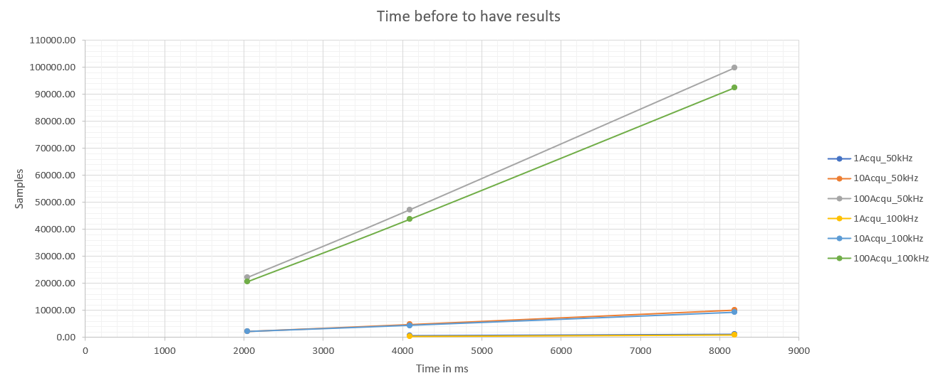
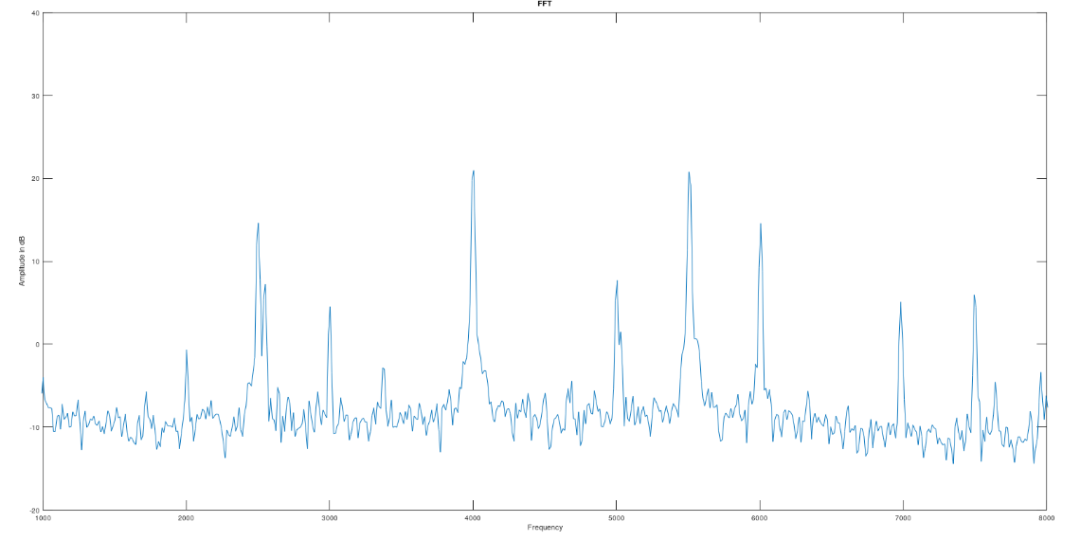
2.4. Code improvement and testing
Improve speed
Aliasing
Run Time graph
Aliasing phenomenon
1. INTRODUCTION
2. WORK DONE
3. CONCLUSION
Notes:
Repliement du spectre et difference de temps de calcul en fonction des paramètres

Slide 17
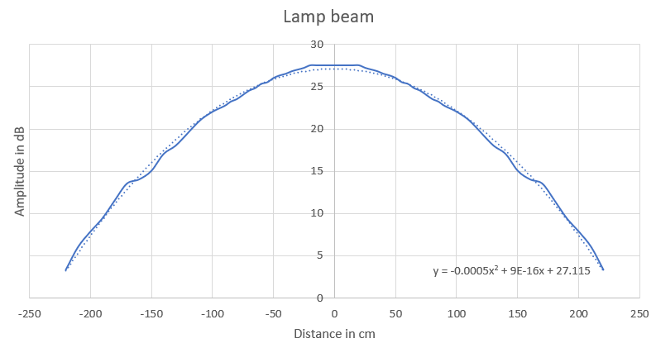
2.5. XY position
Beam lamp
Based on the assumption that the radiation is the same all around the lamp.
Take several points.
Use mathematical tools to draw a polynomial trend curve.
Calculating the equation of the curve.
Calculate the distance using the amplitude of the light signal.
1. INTRODUCTION
2. WORK DONE
3. CONCLUSION
Notes:
Comment avoir l’équation qui permet de connaitre la distance en fonction de l’amplitude

Slide 18
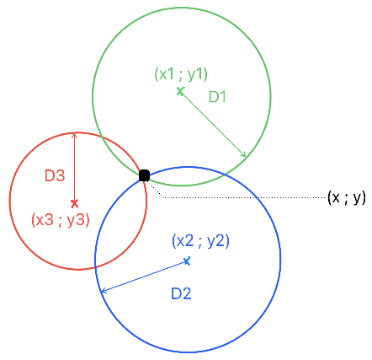
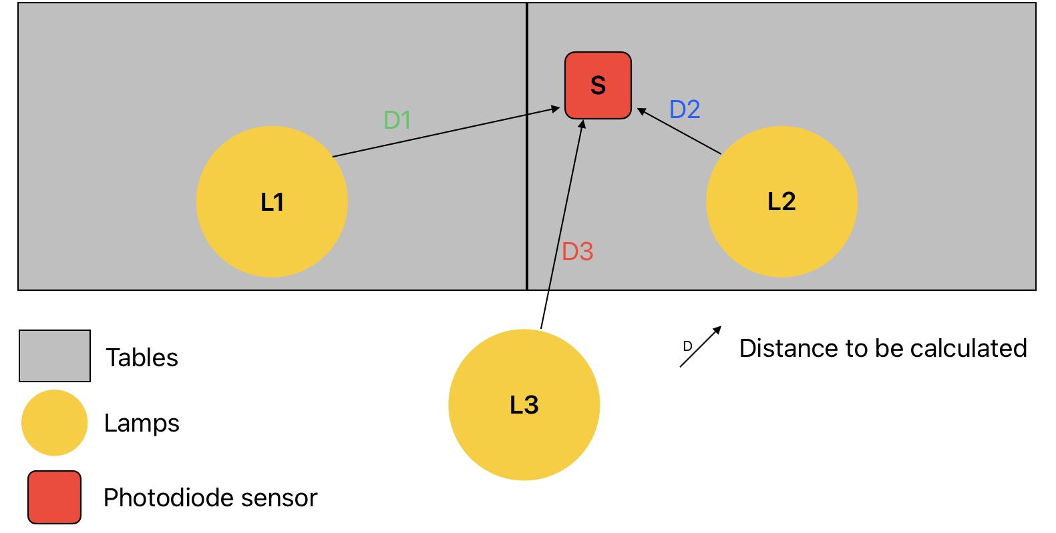
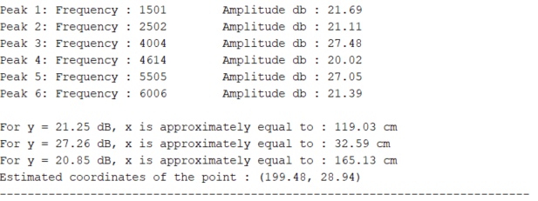
2.5. XY position
Trilateration
D1
D2
D3
1. INTRODUCTION
2. WORK DONE
3. CONCLUSION
Notes:
Explication trilateration

Slide 19
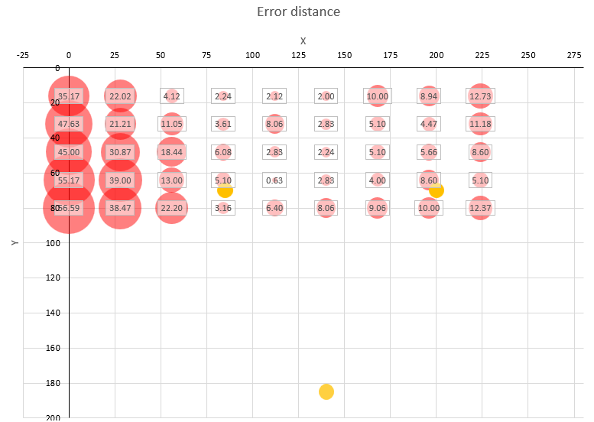
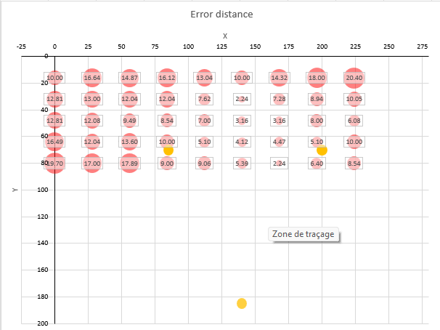
2.6. System errors and limitations
Points taken every 28 cm on the X axis
Points taken every 16 cm on the Y axis
Allows you to see the behavior of the system depending on where the sensor is located on the test table
First equations
14.2 cm error on average
Second equations
10.35 cm error on average
1. INTRODUCTION
2. WORK DONE
3. CONCLUSION
Notes:
Erreur de positionnement entre la réalité et les calculs

Slide 20
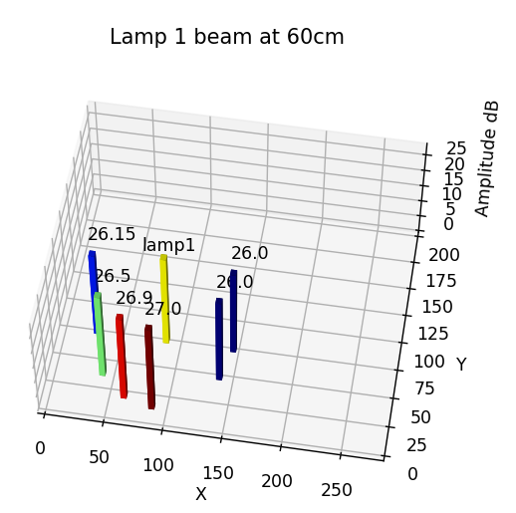
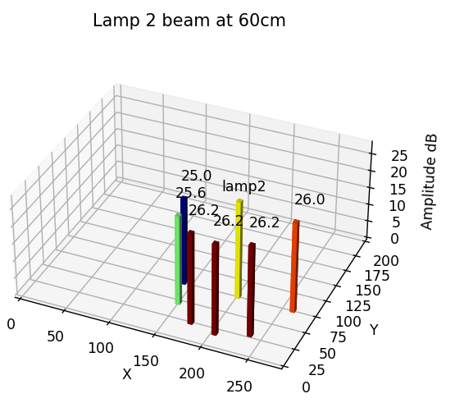
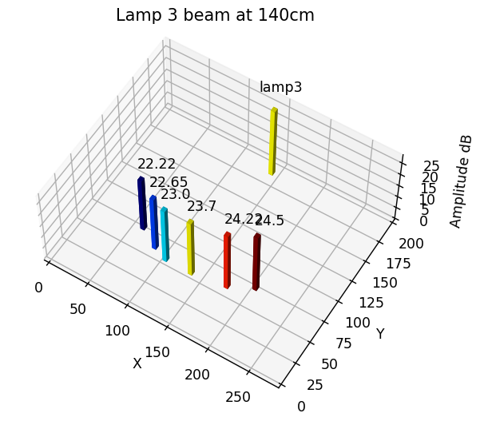
2.6. System errors and limitations
1. INTRODUCTION
2. WORK DONE
3. CONCLUSION
Notes:
One of the causes of errors

Slide 21
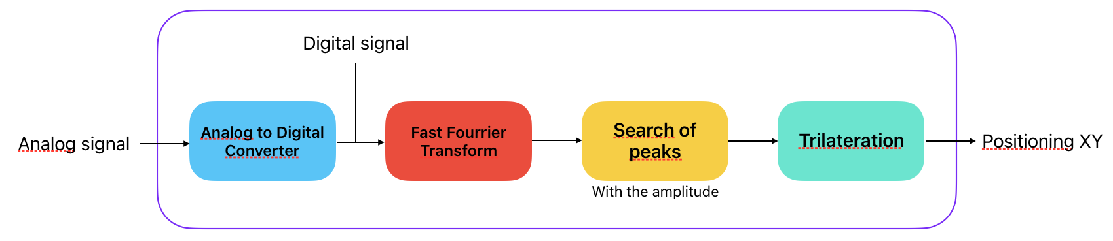
Conclusion
1. INTRODUCTION
2. WORK DONE
3. CONCLUSION

Slide 22
Thanks for your attention

Slide 23
Annexes

Slide 24
Scuola Superiore Sant’Anna
Created in 1987
Honor Courses
Master’s degrees
Master’s Diplomas and Higher Education
PhD Programmes
Seasonal Schools
1. PRESENTATION SANT’ANNA
2. MISSION
3. CONCLUSION

Slide 25
Schematic of the project
1. PRESENTATION SANT’ANNA
2. MISSION
3. CONCLUSION

Slide 26
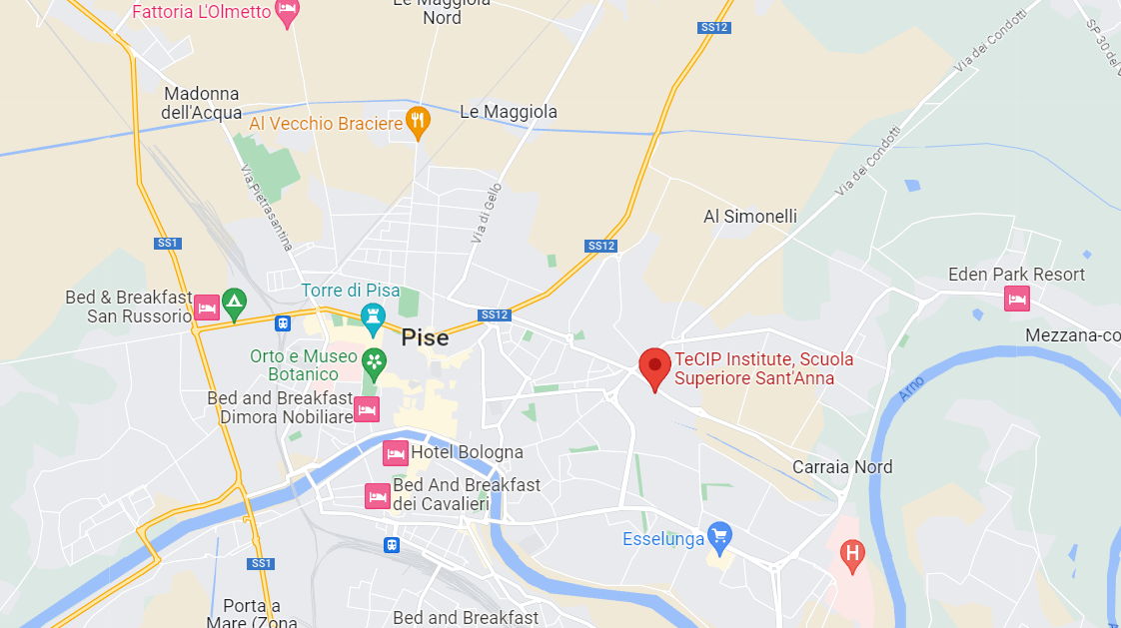
Maps of the TeCIP institute
1. PRESENTATION SANT’ANNA
2. MISSION
3. CONCLUSION

